Slide 1

Enterprise Integration Pattern (EIP) Session 1
Ayman El-Shayeb, Specialist in Egypt Center
Jan 3, 2015
Notes:
This is a sample Title Slide with Picture ideal for including a dark picture with a brief title and subtitle.
A selection of pre-approved title slides are available in the HPE Title Slide Library. The location of the library will be communicated later.
To insert a slide with a different picture from the HPE Title Slide Library:
Open the file HPE_16x9_Title_Slide_Library.pptx
From the Slide thumbnails pane, select the slide with the picture you would like to use in your presentation and click Copy (Ctrl+C)
Open a copy of the new HPE 16x9 template (Standard or Events) or your current presentation
In the Slide thumbnails pane, click Paste (Ctrl+V)
A Paste Options clipboard icon will appear. Click the icon and select Keep Source Formatting. (Ctrl+K)

Slide 2
EIP session series (http://www.enterpriseintegrationpatterns.com)
EIP Introduction
Messaging channels
Messaging constructions
Messaging routing
Messaging Transforming
Messaging End points
System Management
OMS using Apache Camel(initiative)

Slide 3
Agenda
Integration
Message system
Online retailer (Concreate example)

Slide 4
Integration
“Enterprise integration is the task of making separate applications work together to produce a unified set of functionality.”
Integration is not Designing N-Tier distributed applications
Integration Challenges
Networks are unreliable.
Networks are slow
Any two applications are different ( Vendors, platforms , data model , security regions ..)
Change is inevitable.
Applications are built without integration in mind

Slide 5
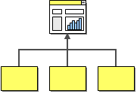
Information Portal
Information portals aggregate information from multiple sources into a single display to avoid having the user access multiple systems for information.
Notes:
This is a sample Picture with Caption slide ideal for including a picture with a brief descriptive statement.
To Replace the Picture on this Sample Slide (this applies to all slides in this template that contain replaceable pictures)
Select the sample picture and press Delete. Click the icon inside the shape to open the Insert Picture dialog box. Navigate to the location where the picture is stored, select desired picture and click on the Insert button to fit the image proportionally within the shape.
Note: Do not right-click the image to change the picture inside the picture placeholder. This will change the frame size of the picture placeholder. Instead, follow the steps outlined above.
Tip: use the Crop tool to reposition a picture within a placeholder. From the Picture Tools Format tab on the ribbon, click the Crop button. Click and drag the picture within the placeholder to reposition. To scale the picture within the placeholder (while Crop is active), grab a round corner handle and drag to resize. Hold Shift key to constrain picture aspect ratio when resizing.

Slide 6
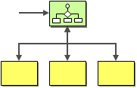
Distributed Business Process
Example of distributed Business Process is managing order process via many systems ( Customer care, Billing, shipping ..)
Notes:
This is a sample Picture with Caption slide ideal for including a picture with a brief descriptive statement.
To Replace the Picture on this Sample Slide (this applies to all slides in this template that contain replaceable pictures)
Select the sample picture and press Delete. Click the icon inside the shape to open the Insert Picture dialog box. Navigate to the location where the picture is stored, select desired picture and click on the Insert button to fit the image proportionally within the shape.
Note: Do not right-click the image to change the picture inside the picture placeholder. This will change the frame size of the picture placeholder. Instead, follow the steps outlined above.
Tip: use the Crop tool to reposition a picture within a placeholder. From the Picture Tools Format tab on the ribbon, click the Crop button. Click and drag the picture within the placeholder to reposition. To scale the picture within the placeholder (while Crop is active), grab a round corner handle and drag to resize. Hold Shift key to constrain picture aspect ratio when resizing.

Slide 7

Business-to-Business Integration
In many cases, business functions may be available from outside suppliers or business partners. For example, the shipping company may provide a service for customers to compute shipping cost or track shipments. Or a business may use an outside provider to compute sales tax rates.
Notes:
This is a sample Picture with Caption slide ideal for including a picture with a brief descriptive statement.
To Replace the Picture on this Sample Slide (this applies to all slides in this template that contain replaceable pictures)
Select the sample picture and press Delete. Click the icon inside the shape to open the Insert Picture dialog box. Navigate to the location where the picture is stored, select desired picture and click on the Insert button to fit the image proportionally within the shape.
Note: Do not right-click the image to change the picture inside the picture placeholder. This will change the frame size of the picture placeholder. Instead, follow the steps outlined above.
Tip: use the Crop tool to reposition a picture within a placeholder. From the Picture Tools Format tab on the ribbon, click the Crop button. Click and drag the picture within the placeholder to reposition. To scale the picture within the placeholder (while Crop is active), grab a round corner handle and drag to resize. Hold Shift key to constrain picture aspect ratio when resizing.

Slide 8
Some Integration methods
File Transfer Have each application produce files of shared data for others to consume, and consume files that others have produced.
Shared Database Have the applications store the data they wish to share in a common database.
Remote Procedure Invocation Have each application expose some of its procedures so that they can be invoked remotely, and have applications invoke those to run behavior and exchange data.
Messaging Have each application connect to a common messaging system, and exchange data and invoke behavior using messages.

Slide 9
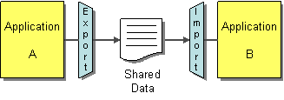
File Transfer
Each application produce files containing information that other applications need to consume.
Integrator takes the responsibility of transforming files into different formats.
Because of time of producing and processing the file . The method is better for batching data that is not changed frequently rather than requests that needs high speed response
Notes:
This is a sample Picture with Caption slide ideal for including a picture with a brief descriptive statement.
To Replace the Picture on this Sample Slide (this applies to all slides in this template that contain replaceable pictures)
Select the sample picture and press Delete. Click the icon inside the shape to open the Insert Picture dialog box. Navigate to the location where the picture is stored, select desired picture and click on the Insert button to fit the image proportionally within the shape.
Note: Do not right-click the image to change the picture inside the picture placeholder. This will change the frame size of the picture placeholder. Instead, follow the steps outlined above.
Tip: use the Crop tool to reposition a picture within a placeholder. From the Picture Tools Format tab on the ribbon, click the Crop button. Click and drag the picture within the placeholder to reposition. To scale the picture within the placeholder (while Crop is active), grab a round corner handle and drag to resize. Hold Shift key to constrain picture aspect ratio when resizing.

Slide 10
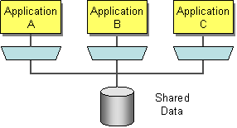
Shared Database
Integrate applications by having them store their data in a single Shared Database.
It keeps the integrity of all data.
Database manages the transactions
Coming up with a unified schema is hard task
In most case, External packages system database can’t be integrated by this way
Change in data model affects many systems (tightly coupled)
performance bottlenecks and even deadlocks may happen
Notes:
This is a sample Picture with Caption slide ideal for including a picture with a brief descriptive statement.
To Replace the Picture on this Sample Slide (this applies to all slides in this template that contain replaceable pictures)
Select the sample picture and press Delete. Click the icon inside the shape to open the Insert Picture dialog box. Navigate to the location where the picture is stored, select desired picture and click on the Insert button to fit the image proportionally within the shape.
Note: Do not right-click the image to change the picture inside the picture placeholder. This will change the frame size of the picture placeholder. Instead, follow the steps outlined above.
Tip: use the Crop tool to reposition a picture within a placeholder. From the Picture Tools Format tab on the ribbon, click the Crop button. Click and drag the picture within the placeholder to reposition. To scale the picture within the placeholder (while Crop is active), grab a round corner handle and drag to resize. Hold Shift key to constrain picture aspect ratio when resizing.

Slide 11
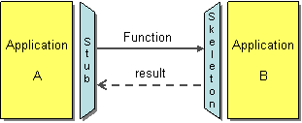
Remote Procedure Invocation
Develop each application as a large-scale object or component with encapsulated data. Provide an interface to allow other applications to interact with the running application.
In the past RPC is used. today , web service is used instead
Good way to share functionality rather than data.
It used synchronize connection and there are different interfaces to each system. Which sometimes make the applications tightly coupled
Notes:
This is a sample Picture with Caption slide ideal for including a picture with a brief descriptive statement.
To Replace the Picture on this Sample Slide (this applies to all slides in this template that contain replaceable pictures)
Select the sample picture and press Delete. Click the icon inside the shape to open the Insert Picture dialog box. Navigate to the location where the picture is stored, select desired picture and click on the Insert button to fit the image proportionally within the shape.
Note: Do not right-click the image to change the picture inside the picture placeholder. This will change the frame size of the picture placeholder. Instead, follow the steps outlined above.
Tip: use the Crop tool to reposition a picture within a placeholder. From the Picture Tools Format tab on the ribbon, click the Crop button. Click and drag the picture within the placeholder to reposition. To scale the picture within the placeholder (while Crop is active), grab a round corner handle and drag to resize. Hold Shift key to constrain picture aspect ratio when resizing.

Slide 12
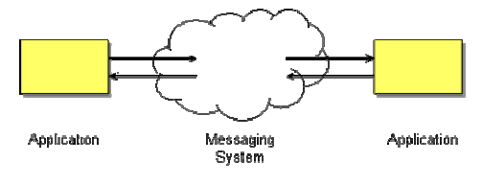
Messaging
Have each application connect to a common messaging system, and exchange data and invoke behavior using messages.
Applications are connected Asynchronously
Message System is responsible for reliable delivery of the message
Design patterns
EAI tools for messaging
messaging is more immediate than File Transfer, better encapsulated than Shared Database, and more reliable than Remote Procedure Invocation. However, that’s just the beginning of the advantages that can be gained using messaging
Complex programming model
Notes:
This is a sample Picture with Caption slide ideal for including a picture with a brief descriptive statement.
To Replace the Picture on this Sample Slide (this applies to all slides in this template that contain replaceable pictures)
Select the sample picture and press Delete. Click the icon inside the shape to open the Insert Picture dialog box. Navigate to the location where the picture is stored, select desired picture and click on the Insert button to fit the image proportionally within the shape.
Note: Do not right-click the image to change the picture inside the picture placeholder. This will change the frame size of the picture placeholder. Instead, follow the steps outlined above.
Tip: use the Crop tool to reposition a picture within a placeholder. From the Picture Tools Format tab on the ribbon, click the Crop button. Click and drag the picture within the placeholder to reposition. To scale the picture within the placeholder (while Crop is active), grab a round corner handle and drag to resize. Hold Shift key to constrain picture aspect ratio when resizing.

Slide 13
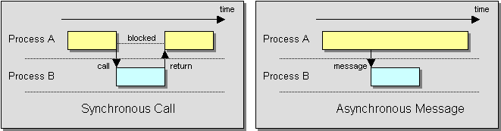
Synchronous Call VS Asynchronous Message
In Asynchronous Message, Process A doesn’t have to wait for reply from Process B.
Notes:
This is a sample Picture with Caption slide ideal for including a picture with a brief descriptive statement.
To Replace the Picture on this Sample Slide (this applies to all slides in this template that contain replaceable pictures)
Select the sample picture and press Delete. Click the icon inside the shape to open the Insert Picture dialog box. Navigate to the location where the picture is stored, select desired picture and click on the Insert button to fit the image proportionally within the shape.
Note: Do not right-click the image to change the picture inside the picture placeholder. This will change the frame size of the picture placeholder. Instead, follow the steps outlined above.
Tip: use the Crop tool to reposition a picture within a placeholder. From the Picture Tools Format tab on the ribbon, click the Crop button. Click and drag the picture within the placeholder to reposition. To scale the picture within the placeholder (while Crop is active), grab a round corner handle and drag to resize. Hold Shift key to constrain picture aspect ratio when resizing.

Slide 14
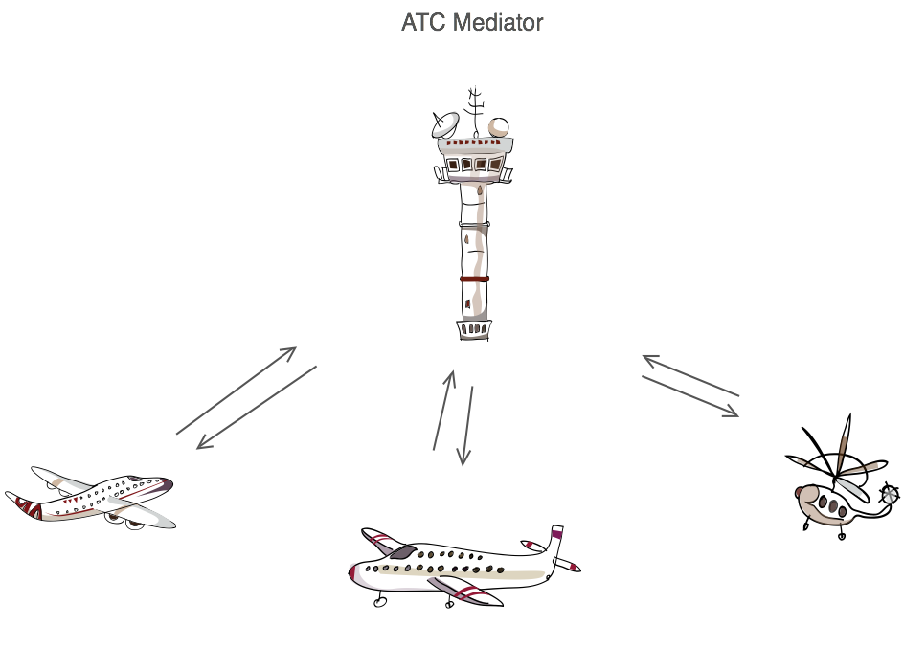
Messaging System
Messaging capabilities are typically provided by a separate software system called a messaging system or message-oriented middleware (MOM).
Messaging System receives, delivers, routes transfers and manage the messages.
Messaging system decouples the sender and receiver.
Messaging System acts like mediator in GOF Mediation Design Pattern.
Notes:
This is a sample Picture with Caption slide ideal for including a picture with a brief descriptive statement.
To Replace the Picture on this Sample Slide (this applies to all slides in this template that contain replaceable pictures)
Select the sample picture and press Delete. Click the icon inside the shape to open the Insert Picture dialog box. Navigate to the location where the picture is stored, select desired picture and click on the Insert button to fit the image proportionally within the shape.
Note: Do not right-click the image to change the picture inside the picture placeholder. This will change the frame size of the picture placeholder. Instead, follow the steps outlined above.
Tip: use the Crop tool to reposition a picture within a placeholder. From the Picture Tools Format tab on the ribbon, click the Crop button. Click and drag the picture within the placeholder to reposition. To scale the picture within the placeholder (while Crop is active), grab a round corner handle and drag to resize. Hold Shift key to constrain picture aspect ratio when resizing.

Slide 15
Loosely Coupling
The core principle behind loose coupling is to reduce the assumptions two parties (components,
applications, services, programs, users) make about each other when they exchange information
Loosely coupling is very important concept in designing Integration solution because systems frequently changes and because of network issues.
Example:
Application A needs to send data ( 1 integer , 1 char , string with length 20) so it does the following
Application A marshals this data as bytes
Application A opens TCP/IP connection with application B
Application A sends the bytes in sequence to B an Close connection
This method misses the loosely coupling principle because it assumes
location : (Location of the sent data should be Application B)
Timeline: (Application B should ready to receive and lessen to port)
Data format: (Application B knows the type of data and its structure)

Slide 16
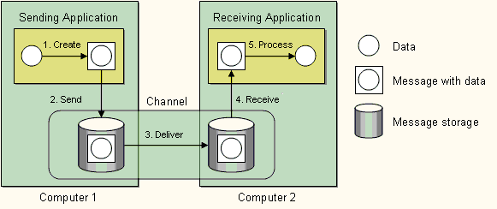
Delivering Message by Messaging system
1. Create — The sender creates the message and populates it with data.
2. Send — The sender adds the message to a channel.
3. Deliver — The messaging system moves the message from the sender’s computer to the receiver’s computer, making it available to the receiver.
4. Receive — The receiver reads the message from the channel.
5. Process — The receiver extracts the data from the message.
Notes:
This is a sample Picture with Caption slide ideal for including a picture with a brief descriptive statement.
To Replace the Picture on this Sample Slide (this applies to all slides in this template that contain replaceable pictures)
Select the sample picture and press Delete. Click the icon inside the shape to open the Insert Picture dialog box. Navigate to the location where the picture is stored, select desired picture and click on the Insert button to fit the image proportionally within the shape.
Note: Do not right-click the image to change the picture inside the picture placeholder. This will change the frame size of the picture placeholder. Instead, follow the steps outlined above.
Tip: use the Crop tool to reposition a picture within a placeholder. From the Picture Tools Format tab on the ribbon, click the Crop button. Click and drag the picture within the placeholder to reposition. To scale the picture within the placeholder (while Crop is active), grab a round corner handle and drag to resize. Hold Shift key to constrain picture aspect ratio when resizing.

Slide 17


Message
Any data that is to be transmitted via a messaging system must be converted into one or more messages that can be sent through messaging channels.
Sender and receiver should marshal and un-marsal the data into/ from one or more massage
Message contains Header and body.
Like real postal mail . Body carries payload (mail) and header (envelop) contains information important to message system
9 EIP related to Message constructions ( Command Message, Document Message, Event Message, Request-Reply, Return Address, Correlation Identifier, Message Sequence, Message Expiration, Format Indicator)
Package the information into a Message, a data record that the messaging system can transmit through a message channel.
Notes:
This is a sample Picture with Caption slide ideal for including a picture with a brief descriptive statement.
To Replace the Picture on this Sample Slide (this applies to all slides in this template that contain replaceable pictures)
Select the sample picture and press Delete. Click the icon inside the shape to open the Insert Picture dialog box. Navigate to the location where the picture is stored, select desired picture and click on the Insert button to fit the image proportionally within the shape.
Note: Do not right-click the image to change the picture inside the picture placeholder. This will change the frame size of the picture placeholder. Instead, follow the steps outlined above.
Tip: use the Crop tool to reposition a picture within a placeholder. From the Picture Tools Format tab on the ribbon, click the Crop button. Click and drag the picture within the placeholder to reposition. To scale the picture within the placeholder (while Crop is active), grab a round corner handle and drag to resize. Hold Shift key to constrain picture aspect ratio when resizing.

Slide 18

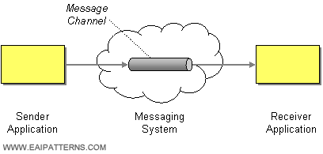
Message Channel
When an application has information to communicate, it doesn't just fling the information into the messaging system, it adds the information to a particular Message Channel. An application receiving information doesn't just pick it up at random from the messaging system; it retrieves the information from a particular Message Channel.
logical pipe to send messages
Receiver and sender don’t need to know each other . Both just send and receive from specific channel
Channel can be point to point or publish subscriber
Integration Developer should configure channels inside message system
9 EIP elements related to Message channels ( Point to point channel , Publish subscriber channel, Datatype Channel, Invalid Message Channel, Dead Letter Channel, Guaranteed Delivery, Channel Adapter, Messaging Bridge, Message Bus)
Connect the applications using a Message Channel, where one application writes information to the channel and the other one reads that information from the channel.
Notes:
This is a sample Picture with Caption slide ideal for including a picture with a brief descriptive statement.
To Replace the Picture on this Sample Slide (this applies to all slides in this template that contain replaceable pictures)
Select the sample picture and press Delete. Click the icon inside the shape to open the Insert Picture dialog box. Navigate to the location where the picture is stored, select desired picture and click on the Insert button to fit the image proportionally within the shape.
Note: Do not right-click the image to change the picture inside the picture placeholder. This will change the frame size of the picture placeholder. Instead, follow the steps outlined above.
Tip: use the Crop tool to reposition a picture within a placeholder. From the Picture Tools Format tab on the ribbon, click the Crop button. Click and drag the picture within the placeholder to reposition. To scale the picture within the placeholder (while Crop is active), grab a round corner handle and drag to resize. Hold Shift key to constrain picture aspect ratio when resizing.

Slide 19

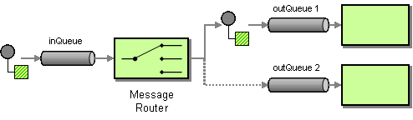
Message Router
One of responsibility of Messaging system is to route the messages between ( source and destination ) and between channels
Every Message type has certain path
Routing enable message system to reuse component.
Router can decide the destination based on content or other criteria like environment conditions
12 EIP for Router ( Content-Based Router, Message Filter, Dynamic Router, Recipient List, Splitter, Aggregator, Resequencer, Composed Message Processor, Scatter-Gather, Routing Slip, Process Manager, Message Broker)
Insert a special filter, a Message Router, which consumes a Message from one Message Channel and republishes it to a different Message Channel depending on a set of conditions.
Notes:
This is a sample Picture with Caption slide ideal for including a picture with a brief descriptive statement.
To Replace the Picture on this Sample Slide (this applies to all slides in this template that contain replaceable pictures)
Select the sample picture and press Delete. Click the icon inside the shape to open the Insert Picture dialog box. Navigate to the location where the picture is stored, select desired picture and click on the Insert button to fit the image proportionally within the shape.
Note: Do not right-click the image to change the picture inside the picture placeholder. This will change the frame size of the picture placeholder. Instead, follow the steps outlined above.
Tip: use the Crop tool to reposition a picture within a placeholder. From the Picture Tools Format tab on the ribbon, click the Crop button. Click and drag the picture within the placeholder to reposition. To scale the picture within the placeholder (while Crop is active), grab a round corner handle and drag to resize. Hold Shift key to constrain picture aspect ratio when resizing.

Slide 20

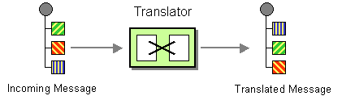
Message Translator
Message is routed between different systems . Each of them has different data model. Messaging system should translate messages to decouple systems.
Translator is similar to Adaptor design pattern
Translator is main component for decoupling
6 EIP related to Translator ( Envelope Wrapper, Content Enricher, Content Filter, Claim Check, Normalizer, Canonical Data Model)
Use a special filter, a Message Translator, between other filters or applications to translate one data format into another.
Notes:
This is a sample Picture with Caption slide ideal for including a picture with a brief descriptive statement.
To Replace the Picture on this Sample Slide (this applies to all slides in this template that contain replaceable pictures)
Select the sample picture and press Delete. Click the icon inside the shape to open the Insert Picture dialog box. Navigate to the location where the picture is stored, select desired picture and click on the Insert button to fit the image proportionally within the shape.
Note: Do not right-click the image to change the picture inside the picture placeholder. This will change the frame size of the picture placeholder. Instead, follow the steps outlined above.
Tip: use the Crop tool to reposition a picture within a placeholder. From the Picture Tools Format tab on the ribbon, click the Crop button. Click and drag the picture within the placeholder to reposition. To scale the picture within the placeholder (while Crop is active), grab a round corner handle and drag to resize. Hold Shift key to constrain picture aspect ratio when resizing.

Slide 21

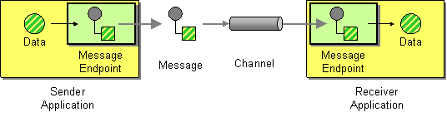
Message Endpoint
The Message Endpoint encapsulates the messaging system from the rest of the application and provide API to convert application data to messages and send to messaging system
Applications and massaging system connect to gather via End points
Message Endpoint code is custom to both the application and the messaging system’s client API
11 EIP related to Endpoints ( Messaging Gateway, Messaging Mapper, Transactional Client, Polling Consumer, Event-Driven Consumer, Competing Consumers, Message Dispatcher, Selective Consumer, Durable Subscriber, Idempotent Receiver, Service Activator)
Connect an application to a messaging channel using a Message Endpoint, a client of the messaging system that the application can then use to send or receive messages.
Notes:
This is a sample Picture with Caption slide ideal for including a picture with a brief descriptive statement.
To Replace the Picture on this Sample Slide (this applies to all slides in this template that contain replaceable pictures)
Select the sample picture and press Delete. Click the icon inside the shape to open the Insert Picture dialog box. Navigate to the location where the picture is stored, select desired picture and click on the Insert button to fit the image proportionally within the shape.
Note: Do not right-click the image to change the picture inside the picture placeholder. This will change the frame size of the picture placeholder. Instead, follow the steps outlined above.
Tip: use the Crop tool to reposition a picture within a placeholder. From the Picture Tools Format tab on the ribbon, click the Crop button. Click and drag the picture within the placeholder to reposition. To scale the picture within the placeholder (while Crop is active), grab a round corner handle and drag to resize. Hold Shift key to constrain picture aspect ratio when resizing.

Slide 22
System management
Messaging systems need to control and monitor the messages for administration purpose.
9 EIP related to System Management (Control Bus, System Management, Test Message, Detour, Wire Tap, Message History, Message Store, Smart Proxy, Test Message, Channel Purger)

Slide 23


Pipes and Filters
Each filter exposes a very simple interface: it receives messages on the inbound pipe, processes the message, and publishes the results to the outbound pipe. The pipe connects one filter to the next, sending output messages from one filter to the next. Because all component use the same external interface they can be composed into different solutions by connecting the components to different pipes. We can add new filters, omit existing ones or rearrange them into a new sequence -- all without having to change the filters themselves. The connection between filter and pipe is sometimes called port. In the basic form, each filter component has one input port and one output port.
Increases reusability , flexibility
Easier for testing and debugging
Use the Pipes and Filters architectural style to divide a larger processing task into a sequence of smaller, independent processing steps (Filters) that are connected by channels (Pipes).
Notes:
This is a sample Picture with Caption slide ideal for including a picture with a brief descriptive statement.
To Replace the Picture on this Sample Slide (this applies to all slides in this template that contain replaceable pictures)
Select the sample picture and press Delete. Click the icon inside the shape to open the Insert Picture dialog box. Navigate to the location where the picture is stored, select desired picture and click on the Insert button to fit the image proportionally within the shape.
Note: Do not right-click the image to change the picture inside the picture placeholder. This will change the frame size of the picture placeholder. Instead, follow the steps outlined above.
Tip: use the Crop tool to reposition a picture within a placeholder. From the Picture Tools Format tab on the ribbon, click the Crop button. Click and drag the picture within the placeholder to reposition. To scale the picture within the placeholder (while Crop is active), grab a round corner handle and drag to resize. Hold Shift key to constrain picture aspect ratio when resizing.

Slide 24
Pipes and Filters
The delay between two messages in case of piping equals the delay in filter with biggest delay
Use the Pipes and Filters architectural style to divide a larger processing task into a sequence of smaller, independent processing steps (Filters) that are connected by channels (Pipes).
Notes:
This is a sample Picture with Caption slide ideal for including a picture with a brief descriptive statement.
To Replace the Picture on this Sample Slide (this applies to all slides in this template that contain replaceable pictures)
Select the sample picture and press Delete. Click the icon inside the shape to open the Insert Picture dialog box. Navigate to the location where the picture is stored, select desired picture and click on the Insert button to fit the image proportionally within the shape.
Note: Do not right-click the image to change the picture inside the picture placeholder. This will change the frame size of the picture placeholder. Instead, follow the steps outlined above.
Tip: use the Crop tool to reposition a picture within a placeholder. From the Picture Tools Format tab on the ribbon, click the Crop button. Click and drag the picture within the placeholder to reposition. To scale the picture within the placeholder (while Crop is active), grab a round corner handle and drag to resize. Hold Shift key to constrain picture aspect ratio when resizing.

Slide 25
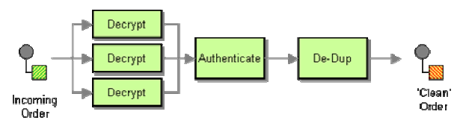
Pipes and Filters
We can use parallel processing to increase performance but may be we need sequencer to reorder the messages.
Use the Pipes and Filters architectural style to divide a larger processing task into a sequence of smaller, independent processing steps (Filters) that are connected by channels (Pipes).
Notes:
This is a sample Picture with Caption slide ideal for including a picture with a brief descriptive statement.
To Replace the Picture on this Sample Slide (this applies to all slides in this template that contain replaceable pictures)
Select the sample picture and press Delete. Click the icon inside the shape to open the Insert Picture dialog box. Navigate to the location where the picture is stored, select desired picture and click on the Insert button to fit the image proportionally within the shape.
Note: Do not right-click the image to change the picture inside the picture placeholder. This will change the frame size of the picture placeholder. Instead, follow the steps outlined above.
Tip: use the Crop tool to reposition a picture within a placeholder. From the Picture Tools Format tab on the ribbon, click the Crop button. Click and drag the picture within the placeholder to reposition. To scale the picture within the placeholder (while Crop is active), grab a round corner handle and drag to resize. Hold Shift key to constrain picture aspect ratio when resizing.

Slide 26
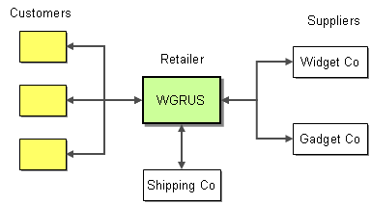
Widget-Gadget Corp -- An Example
Take Orders: Customers can place orders via Web, phone or fax
Process Orders: Processing an order involves multiple steps, including verifying inventory, shipping the goods and invoicing the customer
Check Status: Customers can check the order status
Notes:
This is a sample Picture with Caption slide ideal for including a picture with a brief descriptive statement.
To Replace the Picture on this Sample Slide (this applies to all slides in this template that contain replaceable pictures)
Select the sample picture and press Delete. Click the icon inside the shape to open the Insert Picture dialog box. Navigate to the location where the picture is stored, select desired picture and click on the Insert button to fit the image proportionally within the shape.
Note: Do not right-click the image to change the picture inside the picture placeholder. This will change the frame size of the picture placeholder. Instead, follow the steps outlined above.
Tip: use the Crop tool to reposition a picture within a placeholder. From the Picture Tools Format tab on the ribbon, click the Crop button. Click and drag the picture within the placeholder to reposition. To scale the picture within the placeholder (while Crop is active), grab a round corner handle and drag to resize. Hold Shift key to constrain picture aspect ratio when resizing.

Slide 27
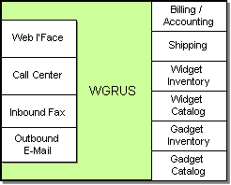
Internal Systems
Widget-Gadget Corp is not green field.
It has already existing systems
3 Sales channels(Web interface, Call Center, inbound Fax)
Outbound Mail to send message to customer
Billing/Accounting system
Shipping System
2 Inventory systems ( one for widget and other for gadget )
2 Catalog systems ( one for widget and other for gadget )
Notes:
This is a sample Picture with Caption slide ideal for including a picture with a brief descriptive statement.
To Replace the Picture on this Sample Slide (this applies to all slides in this template that contain replaceable pictures)
Select the sample picture and press Delete. Click the icon inside the shape to open the Insert Picture dialog box. Navigate to the location where the picture is stored, select desired picture and click on the Insert button to fit the image proportionally within the shape.
Note: Do not right-click the image to change the picture inside the picture placeholder. This will change the frame size of the picture placeholder. Instead, follow the steps outlined above.
Tip: use the Crop tool to reposition a picture within a placeholder. From the Picture Tools Format tab on the ribbon, click the Crop button. Click and drag the picture within the placeholder to reposition. To scale the picture within the placeholder (while Crop is active), grab a round corner handle and drag to resize. Hold Shift key to constrain picture aspect ratio when resizing.

Slide 28
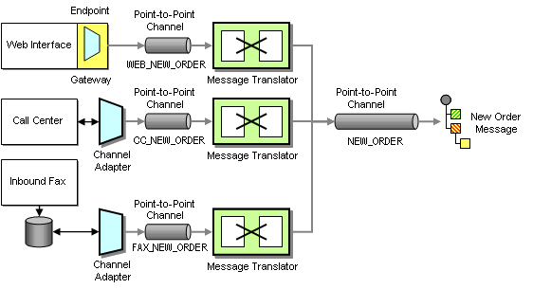
Taking Orders
1- Endpoint (Gateway, Channel Adapter)
2- Channels( Point – to-Point, Data Type channel)
3- Translation ( Message Translator)
4- Message ( Canonical Data Model, Document Message)
Notes:
This is a sample Picture with Caption slide ideal for including a picture with a brief descriptive statement.
To Replace the Picture on this Sample Slide (this applies to all slides in this template that contain replaceable pictures)
Select the sample picture and press Delete. Click the icon inside the shape to open the Insert Picture dialog box. Navigate to the location where the picture is stored, select desired picture and click on the Insert button to fit the image proportionally within the shape.
Note: Do not right-click the image to change the picture inside the picture placeholder. This will change the frame size of the picture placeholder. Instead, follow the steps outlined above.
Tip: use the Crop tool to reposition a picture within a placeholder. From the Picture Tools Format tab on the ribbon, click the Crop button. Click and drag the picture within the placeholder to reposition. To scale the picture within the placeholder (while Crop is active), grab a round corner handle and drag to resize. Hold Shift key to constrain picture aspect ratio when resizing.

Slide 29
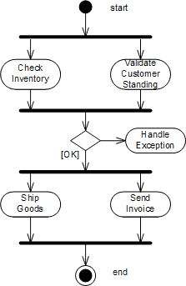
Processing Orders
1- Check stock in inventory system and customer credit level in billing system(in parallel )
2- if the order is ok , then ship the order in shipping system and send invoice otherwise handle it as expectation
Notes:
This is a sample Picture with Caption slide ideal for including a picture with a brief descriptive statement.
To Replace the Picture on this Sample Slide (this applies to all slides in this template that contain replaceable pictures)
Select the sample picture and press Delete. Click the icon inside the shape to open the Insert Picture dialog box. Navigate to the location where the picture is stored, select desired picture and click on the Insert button to fit the image proportionally within the shape.
Note: Do not right-click the image to change the picture inside the picture placeholder. This will change the frame size of the picture placeholder. Instead, follow the steps outlined above.
Tip: use the Crop tool to reposition a picture within a placeholder. From the Picture Tools Format tab on the ribbon, click the Crop button. Click and drag the picture within the placeholder to reposition. To scale the picture within the placeholder (while Crop is active), grab a round corner handle and drag to resize. Hold Shift key to constrain picture aspect ratio when resizing.

Slide 30
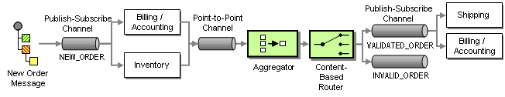
Processing Orders
1- channels(publish-subscriber, invalid message channel)
2- Router (Aggregator – Content based router)
Notes:
This is a sample Picture with Caption slide ideal for including a picture with a brief descriptive statement.
To Replace the Picture on this Sample Slide (this applies to all slides in this template that contain replaceable pictures)
Select the sample picture and press Delete. Click the icon inside the shape to open the Insert Picture dialog box. Navigate to the location where the picture is stored, select desired picture and click on the Insert button to fit the image proportionally within the shape.
Note: Do not right-click the image to change the picture inside the picture placeholder. This will change the frame size of the picture placeholder. Instead, follow the steps outlined above.
Tip: use the Crop tool to reposition a picture within a placeholder. From the Picture Tools Format tab on the ribbon, click the Crop button. Click and drag the picture within the placeholder to reposition. To scale the picture within the placeholder (while Crop is active), grab a round corner handle and drag to resize. Hold Shift key to constrain picture aspect ratio when resizing.

Slide 31
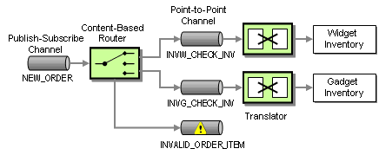
Processing Orders
There are 2 inventories one for Widget item and other for gadget item.
1- Routing (Content-Based Router)
2- Channel (invalid message channel)
3- Message ( Command message)
Notes:
This is a sample Picture with Caption slide ideal for including a picture with a brief descriptive statement.
To Replace the Picture on this Sample Slide (this applies to all slides in this template that contain replaceable pictures)
Select the sample picture and press Delete. Click the icon inside the shape to open the Insert Picture dialog box. Navigate to the location where the picture is stored, select desired picture and click on the Insert button to fit the image proportionally within the shape.
Note: Do not right-click the image to change the picture inside the picture placeholder. This will change the frame size of the picture placeholder. Instead, follow the steps outlined above.
Tip: use the Crop tool to reposition a picture within a placeholder. From the Picture Tools Format tab on the ribbon, click the Crop button. Click and drag the picture within the placeholder to reposition. To scale the picture within the placeholder (while Crop is active), grab a round corner handle and drag to resize. Hold Shift key to constrain picture aspect ratio when resizing.

Slide 32
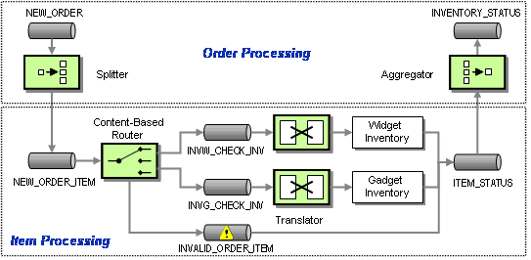
Processing Orders
If the order contains more than one item, we should use splitter to split one message to many massage each one has one item and aggregator to combine the message again
1- Routing ( Splitter, Aggregator)
Notes:
This is a sample Picture with Caption slide ideal for including a picture with a brief descriptive statement.
To Replace the Picture on this Sample Slide (this applies to all slides in this template that contain replaceable pictures)
Select the sample picture and press Delete. Click the icon inside the shape to open the Insert Picture dialog box. Navigate to the location where the picture is stored, select desired picture and click on the Insert button to fit the image proportionally within the shape.
Note: Do not right-click the image to change the picture inside the picture placeholder. This will change the frame size of the picture placeholder. Instead, follow the steps outlined above.
Tip: use the Crop tool to reposition a picture within a placeholder. From the Picture Tools Format tab on the ribbon, click the Crop button. Click and drag the picture within the placeholder to reposition. To scale the picture within the placeholder (while Crop is active), grab a round corner handle and drag to resize. Hold Shift key to constrain picture aspect ratio when resizing.

Slide 33
Processing Orders
We have to add order ID to correlate original message with sub massages
1- Transformation ( Content Enricher)
Notes:
This is a sample Picture with Caption slide ideal for including a picture with a brief descriptive statement.
To Replace the Picture on this Sample Slide (this applies to all slides in this template that contain replaceable pictures)
Select the sample picture and press Delete. Click the icon inside the shape to open the Insert Picture dialog box. Navigate to the location where the picture is stored, select desired picture and click on the Insert button to fit the image proportionally within the shape.
Note: Do not right-click the image to change the picture inside the picture placeholder. This will change the frame size of the picture placeholder. Instead, follow the steps outlined above.
Tip: use the Crop tool to reposition a picture within a placeholder. From the Picture Tools Format tab on the ribbon, click the Crop button. Click and drag the picture within the placeholder to reposition. To scale the picture within the placeholder (while Crop is active), grab a round corner handle and drag to resize. Hold Shift key to constrain picture aspect ratio when resizing.

Slide 34
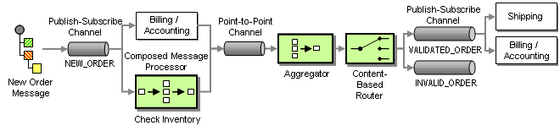
Processing Orders
1- Routing( Composed Message Processor)
Notes:
This is a sample Picture with Caption slide ideal for including a picture with a brief descriptive statement.
To Replace the Picture on this Sample Slide (this applies to all slides in this template that contain replaceable pictures)
Select the sample picture and press Delete. Click the icon inside the shape to open the Insert Picture dialog box. Navigate to the location where the picture is stored, select desired picture and click on the Insert button to fit the image proportionally within the shape.
Note: Do not right-click the image to change the picture inside the picture placeholder. This will change the frame size of the picture placeholder. Instead, follow the steps outlined above.
Tip: use the Crop tool to reposition a picture within a placeholder. From the Picture Tools Format tab on the ribbon, click the Crop button. Click and drag the picture within the placeholder to reposition. To scale the picture within the placeholder (while Crop is active), grab a round corner handle and drag to resize. Hold Shift key to constrain picture aspect ratio when resizing.

Slide 35
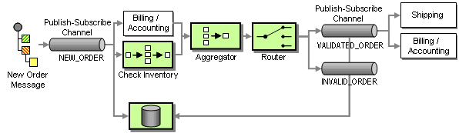
Checking Status
System Management( Message Store)
Notes:
This is a sample Picture with Caption slide ideal for including a picture with a brief descriptive statement.
To Replace the Picture on this Sample Slide (this applies to all slides in this template that contain replaceable pictures)
Select the sample picture and press Delete. Click the icon inside the shape to open the Insert Picture dialog box. Navigate to the location where the picture is stored, select desired picture and click on the Insert button to fit the image proportionally within the shape.
Note: Do not right-click the image to change the picture inside the picture placeholder. This will change the frame size of the picture placeholder. Instead, follow the steps outlined above.
Tip: use the Crop tool to reposition a picture within a placeholder. From the Picture Tools Format tab on the ribbon, click the Crop button. Click and drag the picture within the placeholder to reposition. To scale the picture within the placeholder (while Crop is active), grab a round corner handle and drag to resize. Hold Shift key to constrain picture aspect ratio when resizing.

Slide 36
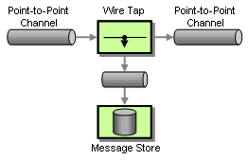
Checking Status
System Management ( Message store, Wire Tap)
Notes:
This is a sample Picture with Caption slide ideal for including a picture with a brief descriptive statement.
To Replace the Picture on this Sample Slide (this applies to all slides in this template that contain replaceable pictures)
Select the sample picture and press Delete. Click the icon inside the shape to open the Insert Picture dialog box. Navigate to the location where the picture is stored, select desired picture and click on the Insert button to fit the image proportionally within the shape.
Note: Do not right-click the image to change the picture inside the picture placeholder. This will change the frame size of the picture placeholder. Instead, follow the steps outlined above.
Tip: use the Crop tool to reposition a picture within a placeholder. From the Picture Tools Format tab on the ribbon, click the Crop button. Click and drag the picture within the placeholder to reposition. To scale the picture within the placeholder (while Crop is active), grab a round corner handle and drag to resize. Hold Shift key to constrain picture aspect ratio when resizing.

Slide 37
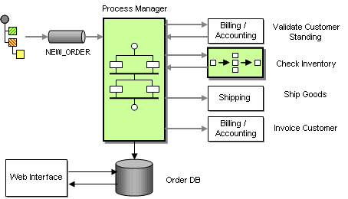
Checking Status
Routing ( Process Manager
Process manger determines the next step (keeps the states) and stores the data between messages.
Notes:
This is a sample Picture with Caption slide ideal for including a picture with a brief descriptive statement.
To Replace the Picture on this Sample Slide (this applies to all slides in this template that contain replaceable pictures)
Select the sample picture and press Delete. Click the icon inside the shape to open the Insert Picture dialog box. Navigate to the location where the picture is stored, select desired picture and click on the Insert button to fit the image proportionally within the shape.
Note: Do not right-click the image to change the picture inside the picture placeholder. This will change the frame size of the picture placeholder. Instead, follow the steps outlined above.
Tip: use the Crop tool to reposition a picture within a placeholder. From the Picture Tools Format tab on the ribbon, click the Crop button. Click and drag the picture within the placeholder to reposition. To scale the picture within the placeholder (while Crop is active), grab a round corner handle and drag to resize. Hold Shift key to constrain picture aspect ratio when resizing.

Slide 38
Thank you
Ayman.el-shayeb@hpe.com

